Slide 1
XG Boost Regressor
- Extreme Gradient Boosting
Form of ensemble learning that combines the predictions of several weak models.
This feature helps it to handle real-world data that contains missing values without having complex pre-processing.
Creates multiple small trees, improving the errors of previous one.
Requires careful tuning of hyperparameters (e.g., learning rate, max depth, number of estimators) for optimal performance.

Slide 2
XG Boost - Advantages
High Performance
Accuracy and Scalability
Flexibility
Widely used Adoption.

Slide 3
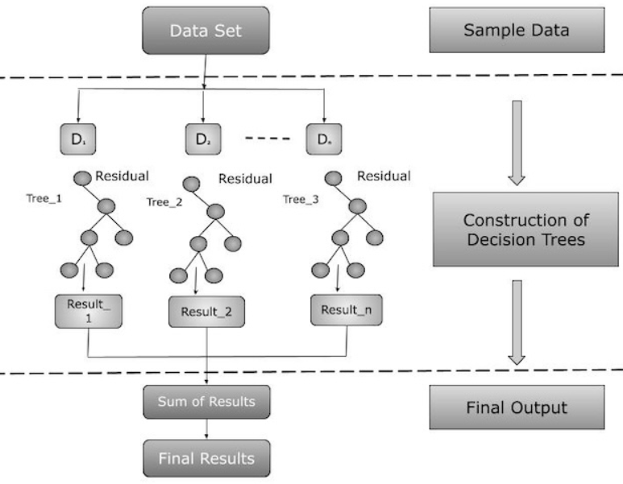
XG Booster – Pictorial Representation

Slide 4
Derivation of R value with different parameters (Verified for Insurance predictor dataset)
Learning rate | N_estimators | Max_depth | Sub sample | Random state | R value
0.1 | 100000 | 10 | 0.8 | 1000 | 0.821
0.1 | 10000 | 10 | 0.8 | 100 | 0.822
0.5 | 100 | 10 | 0.8 | 10 | 0.801
0.5 | 100 | 10 | 0.8 | 100 | 0.796
0.5 | 50 | 10 | 0.8 | 50 | 0.806
0.5 | 5 | 10 | 0.8 | 300 | 0.851

